Slide 1




Team Members:
1) Rana Yash(Leader)
2) Darshan Ramani
3) Omkarsinh Rana
4) Vatsal Raviya
5) Mayur Rathod
Title : MINeD Hackathon
Team Name : TeamUnknown
Team Track : Applied ML for manufacturing industry problem

Slide 2
PROBLEM STATEMENT
Identification of Week Number on Cement Bags on running belt.
Problem Description :- We have to develop a Image processing Algorithm for Identification of Week number on Cement Bag on a running belt, Colour of Character is Black , Cement Bag colour may be black , White, Green, Yellow. In this algorithm if we found any bag without week no , we have put an entry in SQL database (Which will be utilized for stopping the Belt)

Slide 3
INTRODUCTION
So, basically we have input-dataset in the form of video files..
And we need to identify the labels(week number) from the passing Cement bags.
if cement bag doesn't contain any serial number or anything, should create sql query.
Requirements to execute the python Jupyter Notebook(.ipynb) file
1) You need to install the latest version(good to have) or python interpreter.
2) You can install any platform such as pycharm, Visual Studio Code etc to run your code.
3) Also, if you want to execute .ipynb files, the system should have anaconda-opensource platform which
will help to compile, run and execute your notebook.
4) Install the required input videos .
5) You need to modify the paths of input where your videos are there.Otherwise an error will be generated.
5) Run the cells one by one.
5) If given folders do not exist then it will automatically create in current directory.
6) Output files will be generated, extracting the characters from giver Cement Bags.
serial number or anything, should create sql query.

Slide 4
Proposed Approach
We have done using OpenCV - computer vision technique, which is the most useful library to work with the video processing, Image-Processing data, Applying different filters, removing noise, sharpen the image etc.
so, after loading the required modules, we extract the images from 2 different videos and store it inside the sample_images folder. then after in order to sharpen the image(become more brighter) we apply the filter and we assign middle value as 13 using trial and error. After that we checked with conversion of BGR to HSV image and again checking in BGR images.
The output images will contain detected characters format in given cement bags....
2 folders . 1) contains HSV images
2) contains Grayscale Images
In both the files, the output images will show the extracted label (characters) in both the forms, either in Grayscale image, or in HSV image..
You might feel, like little bit blur kind of an images that the output has generated but, we have tried all the noise-removal filters, function and so on and come up with the best solution

Slide 5
Why should one choose our solution?
We have done at our level best, and we are very much closed to extract the characters(especially week numbers), also we are very much excited and enthusiastic to explore more things related to OpenCV library.
This is the problem where we love to do task and we find it very interesting and in future we are ready to do our best in our Problem statement (Identification of week numbers) .
I(Team Leader) personally familiar with OpenCV task and done image-processing related activity.
Also I have done one project related to OpenCV only name Virtual Paint Brush in which you can write in screen using your fingers .
So, I am much familiar with this concept.

Slide 6
Limitations of your solution
We have created 2 folders, one is output_images, output_images_Gray, in which you can find it out the extracted-sharpen characters from the original blurry image.
But our main limitation is that the image is still in blurry, also after lots of tried to do Image-to-text recognition ( OCR) but we failed at that point, also we used some kind of filters, thresholding, bitwise operators in OpenCV, but we just come up with extracting and highlighting the written part.
Also, if cement bags does not contain any label, written character, it should generate SQL query which is still left part.
But, it is for sure that it is not the end, we are still working on it, we would appreciate some kind of support .

Slide 7
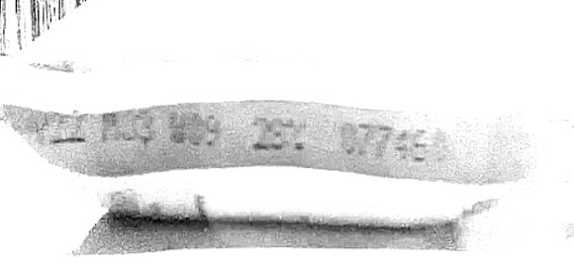
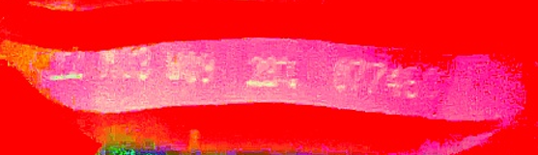
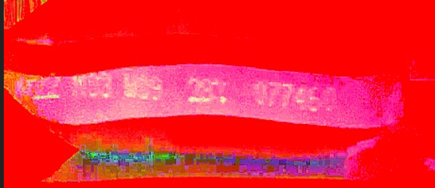
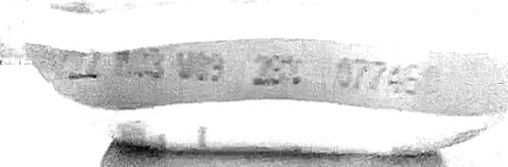
Screenshot/Demonstration of your solution in the form of a video or live demo
Gray-Scale Image
HSV Image

Slide 8

Demonstrated-Video

Slide 9
References
OpenCV library – functions
Thresholding, filters
https://www.life2coding.com/change-brightness-and-contrast-of-images-using-opencv-python/
https://www.analyticsvidhya.com/blog/2021/08/sharpening-an-image-using-opencv-library-in-python/
https://datahacker.rs/004-how-to-smooth-and-sharpen-an-image-in-opencv/
THANK YOU

